Slide 1
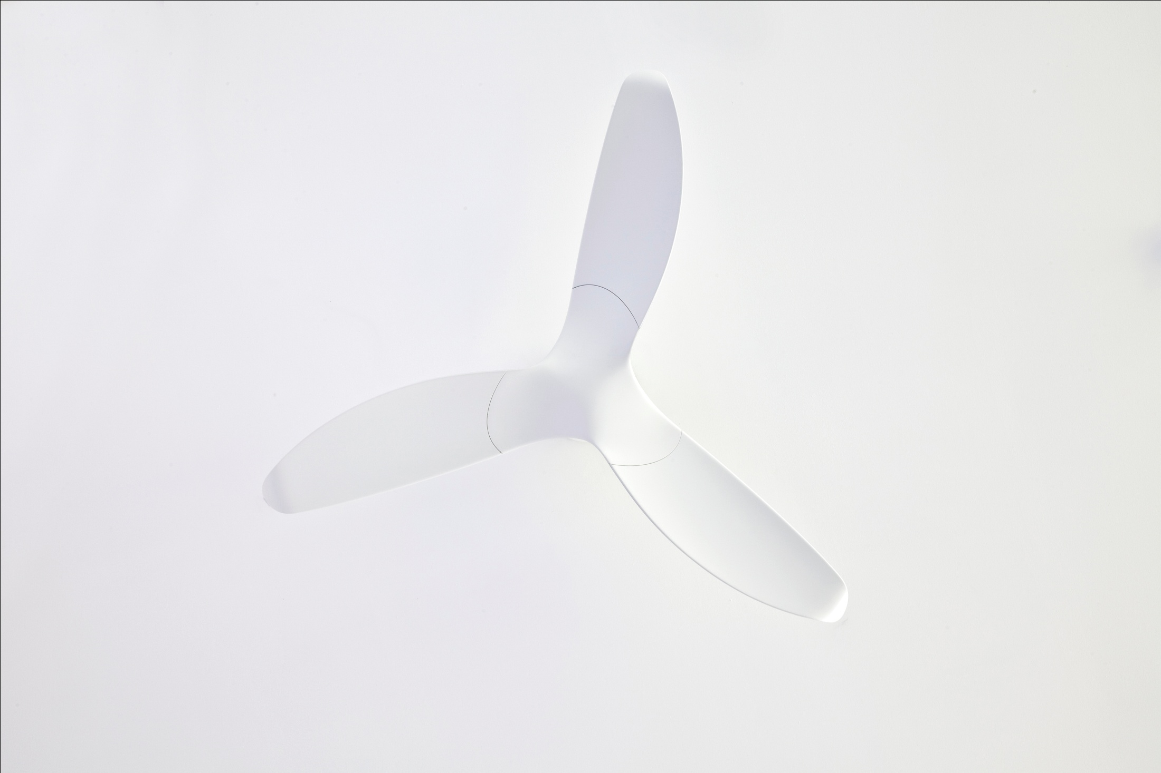
Energy Savings
Indoor heating & cooling
Energy use
<50% of residential buildings
<30% of commercial buildings
Combining Aeratron fans with air condition/heating systems allows up to 50% energy and cost savings on indoor heating and cooling (up to 30% energy demand of commercial buildings).
-Cooling effect on human skin: 4C-8C
-Even air & temperature distribution
-Silent, non disturbing operation
-Improved air circulation resulting in improved health and productivity
University of California (Berkeley) – tests with more than 30k participants
up to 27°C 99% prefer fan to AC
27°C – 30°C >90% prefer fan to AC
>30°C 90% prefer combination of AC/ fan
=

Slide 2
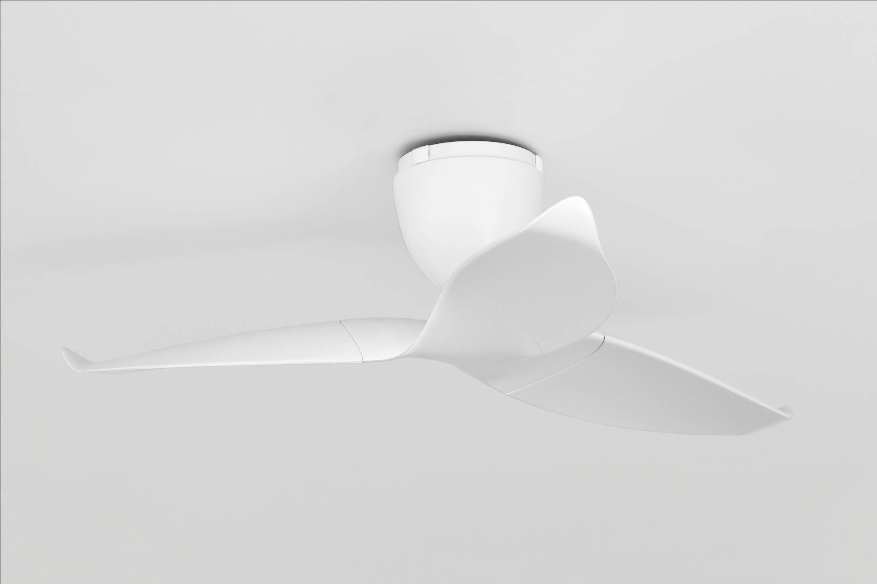
Economics
Summer
Winter
AC
unit
26°C
20°C
28°C
20°C
26°C
24°C
22°C
Heat
20°C
22°C
22°C
18°C
AC
unit
28-30°C
20°C
20°C
28°C
20°C
Reverse air cycle
& even temperature
even air flow plus
cooling effect
HEAT
22-24°C
“perceived” temperature
20°C
20°C

